Slide 1
Accountability and Low-Performing Schools
John Payne
Deputy Superintendent
Latoya Dixon, Ph.D.
Director

Slide 2
ESSA School Accountability: Required Indicators
ESSA requires states to use a set of indicators to measure the performance of all schools. The indicators must:
be applicable to all students,
allow for meaningful differentiation of schools,
be disaggregated by student group (i.e. ethnicity, poverty, disability).
Elementary Schools
Middle
Schools
High
Schools
Academic Achievement
Academic Progress*
English Language Proficiency
School Quality/Student Success
Academic Achievement
Academic Progress*
English Language Proficiency
School Quality/Student Success
Academic Achievement
Graduation Rate
English Language Proficiency
School Quality/Student Success

Slide 3
SC ESSA Plan
How Points are Allocated for School Indicator Ratings
Indicator | Elementary / Middle Schools |  | High Schools
 | Without ELL | With ELL | Without ELL | With ELL
Academic Achievement | 40 | 35 | 30 | 25
Preparing for Success | 10 | 10 | 10 | 10
Student Progress: All Students Lowest Performing 20% of Students | 40 20 20 | 35 17.5 17.5 | N/A | N/A
School Quality | 10 | 10 | 5 | 5
English Learners’ Progress Toward Proficiency | 0 | 10 | 0 | 10
Graduation Rate | N/A | N/A | 30 | 25
College and Career Ready | N/A | N/A | 25 | 25
TOTAL | 100 | 100 | 100 | 100
High School

Slide 4
2018 Ratings
Rating | Elementary | Middle | High
Excellent | 100 | 51 | 36
Good | 135 | 63 | 53
Average | 241 | 118 | 74
Below Average | 122 | 59 | 46
Unsatisfactory | 62 | 30 | 18

Slide 5
Priority
Schools
TSI
Targeted Support
& Improvement Schools
(official identification Nov. 2020)
CSI
Comprehensive
Support &
Improvement Schools
ATSI
Additional
Additional Targeted Support
& Improvement Schools
Based on the performance of the entire school.
Based on subgroup performance (some students) students w/ disabilities, of poverty, race/ethnicity, LEP.

Slide 6
46% (570) of South Carolina’s 1,230 schools are identified for improvement.
Low-Performing Schools in South Carolina
9.5%
41 Comprehensive Support & Improvement Schools
76
Priority
Schools
Schools with
Low-Performing Subgroups South Carolina
36.8%
206
ATSI
Additional Targeted Support & Improvement
247
TSI
Targeted Support and Improvement
Notes:
CSI-41 school; 3% of all schools in the state; 38 unsatisfactory
Priority-76 schools; 6% of all schools in the state; 41 unsatisfactory, 35 below average
ATSI-206 schools; 16% of all schools in the state; 163 unsatisfactory, 21 below average; 22 average
TSI-245 schools; 19% of all schools in the state

Slide 7
Return on Investment
38 low-performing schools served 2016-17 and 2017-18
32 above the bottom 5%
29 above the bottom 10%
6 remain in the bottom 5%
Notes:
3 schools moved from the bottom 5% to the bottom 10% in the state
Allendale County Schools-
Allendale Fairfax High School
Cherokee County Schools-
Mary Bramlett Elementary
Jasper County Schools-
Hardeevillle Elementary School
6 schools returned to the CSI list (bottom 5% performance overall)
Aiken County Public School District
Lloyd Kennedy Charter School
Charleston County School District
Greg Mathis Charter High School
Edmund Burns Elementary School
North Charleston Elementary School
North Charleston High School
Lee County School District
Bishopville Primary School at Dennis

Slide 8
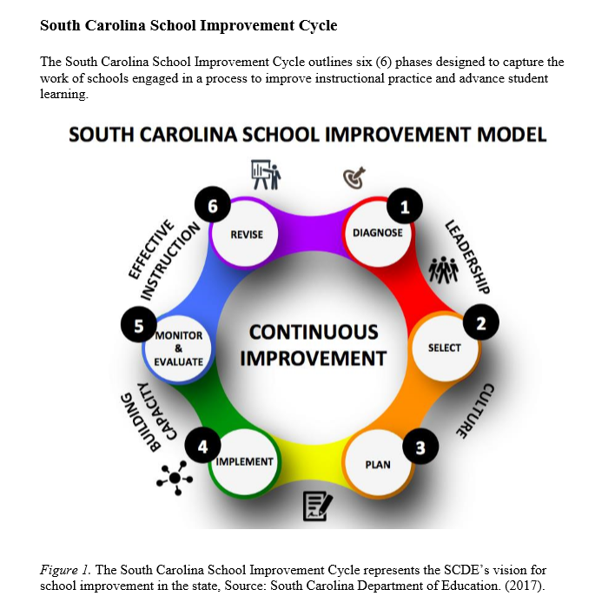
Goals
Improve the instructional leadership capacity of principals;
Improve the pedagogical practices of teachers; and
Improve student outcomes.
Methods
Instructional leadership;
Standards based instruction;
High-yield learning strategies;
Aligned and rigorous assessments;
Evidence-based interventions, practices, and strategies;
Progress monitoring; and
Observation, coaching, and feedback.

